Slide 1
Not
Main idea
Not everything online is genuine. Some pages, ads, and links are designed to trick people into clicking, sharing details, or installing harmful software.
Everything on Social Media is Safe
What this presentation covers
• What phishing means
• Common warning signs
• Real examples from social media
• Simple steps to stay safe
A simple guide for parents on phishing, fake pages, suspicious ads, and dangerous links

Slide 2
1. What is phishing?
A very common online trick
Phishing is when someone pretends to be trustworthy so that people click a link, open a message, give personal details, or download something harmful.
The source may look real: a known page, a familiar person, an ad, a comment, or a message.
But the real goal is often to steal information, install malware, or take control of an account or device.
Simple example
“Read more in this link”
“Claim your prize here”
“Urgent account issue — click now”
Why it works
It uses curiosity, urgency, fear, or excitement to make people click quickly without checking first.

Slide 3
2. Warning signs to notice
Small clues can reveal a trap
A page or ad looks “official” but has a strange name, weak profile details, poor spelling, or odd-looking links.
A post tells people to get “full information” from a comment link instead of a trusted news or company website.
The message pushes you to act quickly before thinking: “limited time”, “urgent”, or “only today”.
Even a blue tick is not enough by itself. It does not automatically mean the page is honest or safe.
Important reminder
Trust the full picture, not just one sign. Check the page name, profile photo, link style, writing quality, and whether the information also appears on a reliable website.

Slide 4
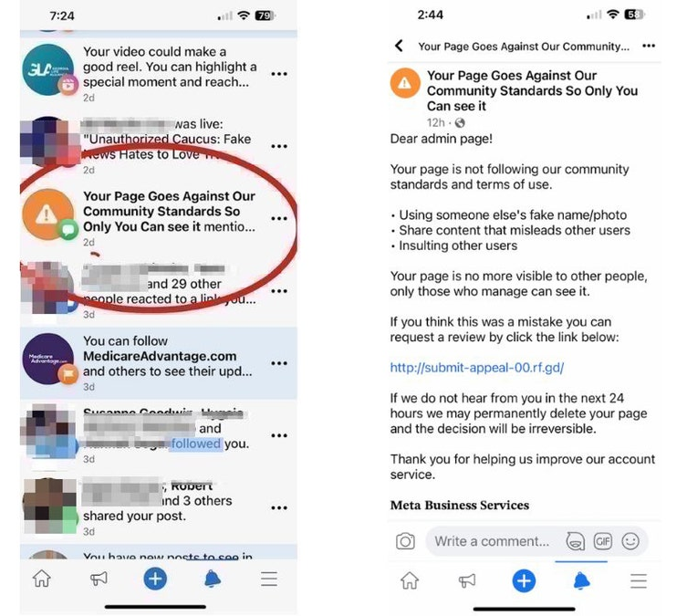
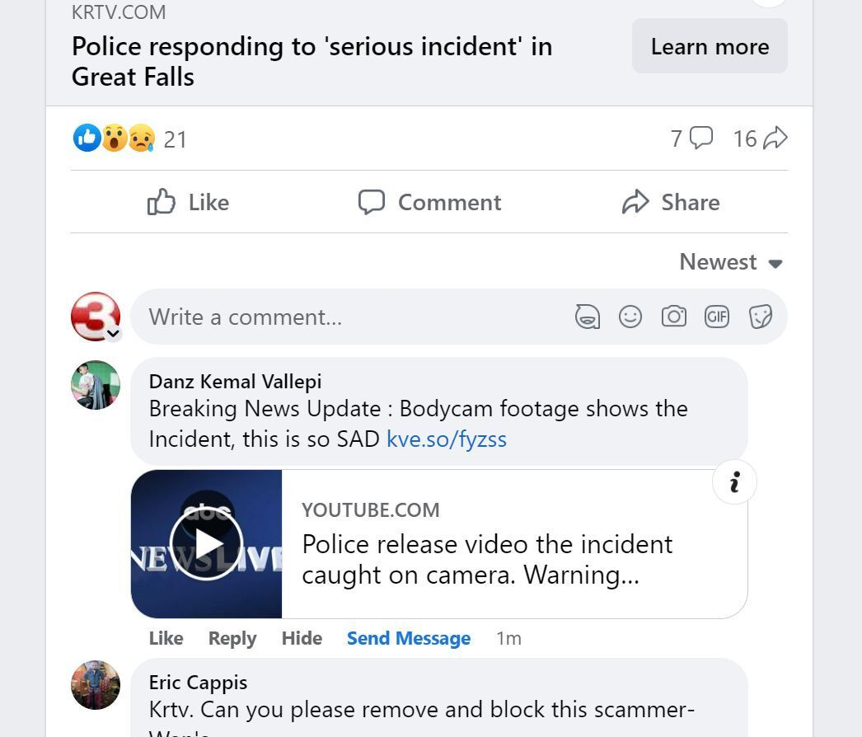
3. Some Examples of Phishing on Social Media
Example 1
Example 2

Slide 5
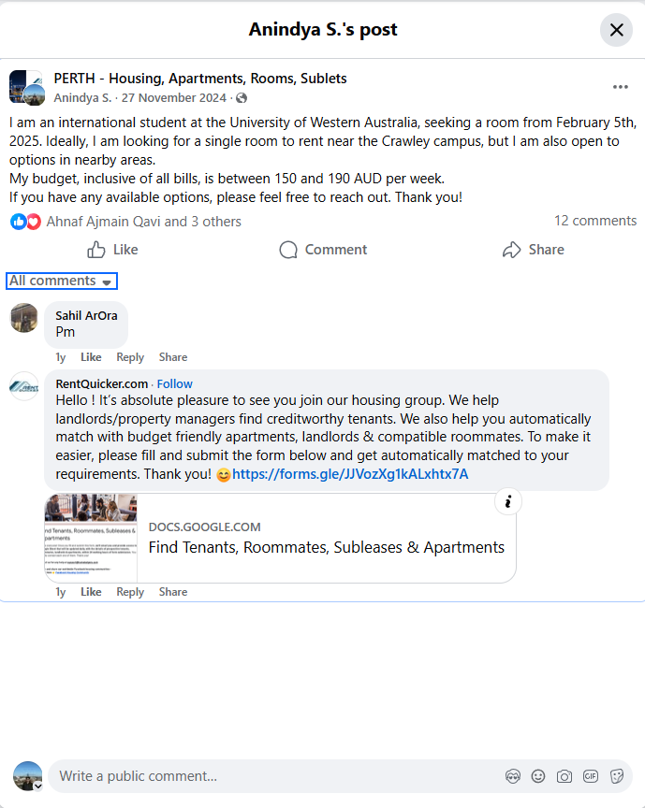
4. My Personal Experience of a
Possible Trap
What happened
Before coming to Australia, I was searching for a rental place in Perth.
I posted in a Facebook rental group because I had no one known there.
What I noticed
Instead of genuine replies, many suspicious accounts responded.
They kept sending random links and urging me to click.
Why it felt suspicious
Some names looked strange
Some names looked normal but still felt untrustworthy.
The offers looked too good to be true and overenthusiastic.
What I learned
This was possibly a phishing attempt or another malicious trap.
Having a little bit of knowledge about these helped me make my decision.
Being careful and not clicking blindly protected me.

Slide 6
5. Real examples people can fall for
These look normal at first
Example A: Comment-link trap
Example B: Suspicious shopping ad
A page shares exciting or shocking news and says the “full story” is in the comments. The link may lead to a fake page, a harmful site, or a file that should never be opened.
An ad shows something attractive and targeted, such as a favourite book. The page may even look professional, but warning signs like a strange page name or missing profile details should not be ignored.
Example C: A known person sends a weird link
Example D: Fake support or account warning
Even if the sender looks familiar, their account may be hacked or impersonated. Never trust a link only because it came from someone you know.
A message may claim that your account has a problem and ask you to “verify now”. Real companies usually direct users to their official app or website, not random links.

Slide 7
6. What to do before clicking
A simple safety checklist
Pause first. Do not click immediately, even if the message looks urgent or interesting.
Check the page name, profile details, and link carefully. Strange names and unusual web addresses are warning signs.
If the topic is news, confirm it from a real news website instead of relying on social media posts.
If the topic is shopping, open the official company website or app yourself rather than using the ad link.
If unsure, ask a trusted family member before clicking.
Best habit
Open trusted websites by typing the address yourself or using the official app. That is safer than following random links.
If you already clicked
Close the page, do not enter details, do not download files, and ask for help quickly.

Slide 8
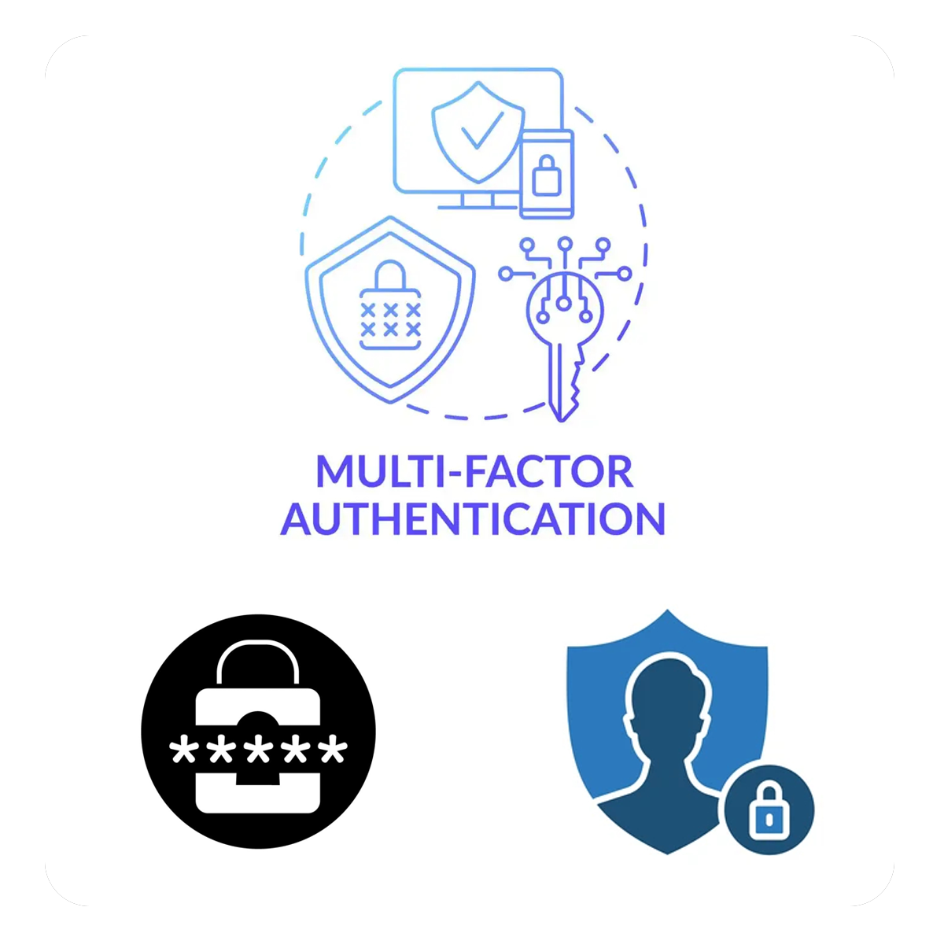
7. Basic Protection Steps Before Problems Happen
Turn on multi-factor authentication
Make accounts private
Do not use overly revealing profile or cover photos
Use strong, long, unique passwords
Do not reuse the same password everywhere
Keep apps and phone updated

Slide 9
8. Important things to remember
## 1
## 3
Not all news on social media is 100 % TRUE.
If there’s no information on the post itself and they want to redirect you, RED FLAG !
## 2
## 4
If anything is too good to be true, it probably is.
Don’t make social media your only source of news. This spreads misinformation.

Slide 10
9. Final message
A safe habit is better than a quick click
If something online feels strange, rushed, or too good to be true, stop and check first.
The safest rule is simple:
Before clicking a link, make sure the page is real, the message makes sense, and the information can be confirmed from a trusted source.
Thank you

